Slide 1
Unit 3
Structured Design

Slide 2
Structured design
A structure design is chart which shows the breakdown of a system to its lowest manageable parts.
Is an example of top down design
The tree shows the relationship between modules, showing data transfer between modules

Slide 3
Structured Design
Structured design partitions the program into small and independent modules.
The advantages of structured design are as following:
  Critical interfaces are tested first.
  It provide abstraction.
  It allows multiple programmers to work simultaneously.
  It allows code reuse.
  It provides control and improves morale.
  It makes identifying structure easier.

Slide 4
Structured Design
A structure chart depicts the modular organization of an information system.
The organization is hierarchical.
A structure chart graphically shows the way the components of a program or a system are related.
The relationships are shown in terms of parameter passing mechanisms applied and the basic structured programming operations namely sequence, selection and repetition.
A structure chart depicts the division of a system into programs along with their internal structure.

Slide 5
Structured Design
Objectives of Using Structured charts
  To encourage a top-down design.
  To support the concept of modules and identify the appropriate modules.
  To show the size and complexity of the system.
  To identify the number of readily identifiable functions and modules within each function.
  To depict whether each identifiable function is a manageable entity or should be broken down into smaller components.

Slide 6
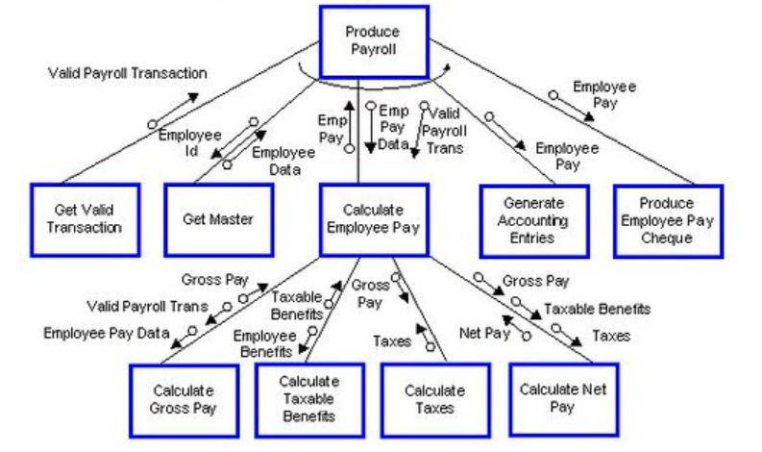
Structured design

Slide 7
Summary
Top down design
Structure chart
Breakdown the modules

